Slide 1
Angular 6
by chanti

Slide 2
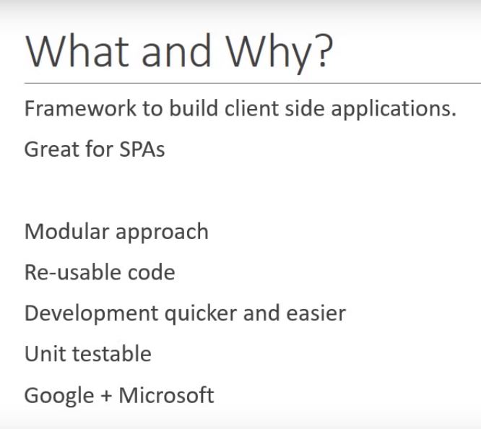

Slide 3
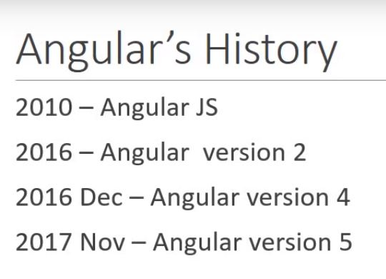

Slide 4
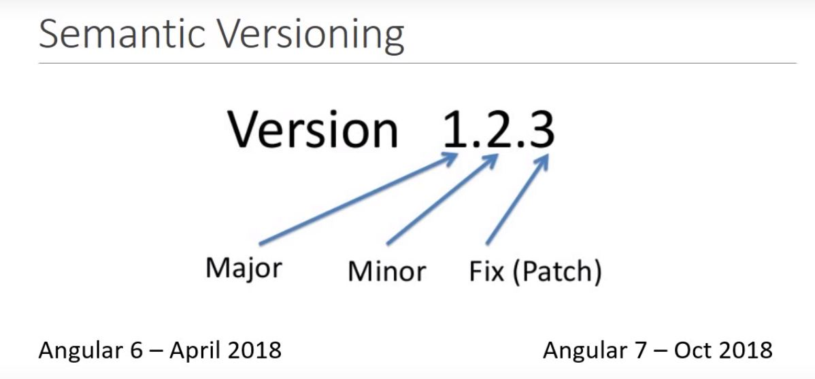

Slide 5
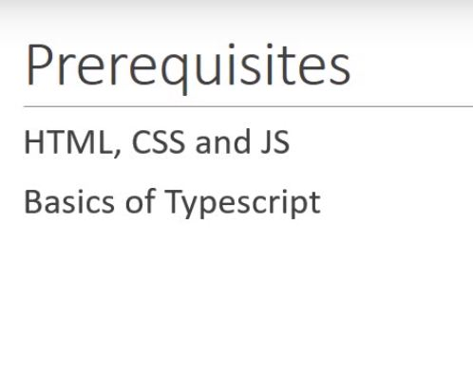

Slide 6
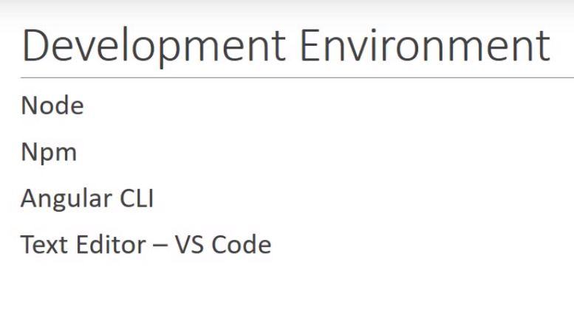

Slide 7
Setting up Angular 7 in Visual Studio:
Step 1 : Download git from https://git-scm.com/ link
Verify: git --version {2.18.0}
Step 2 : Install Node and NPM using the link below. https://nodejs.org/en/download/
Verify: node –version {8.x}
npm --version {5.x}
Step 3 : Install angular cli 7
npm install –g @angular@cli {First Time}
OR
npm install –g @angular@cli@latest {Update}
Verify: ng –version {7.x}
Step 4:Download visual studio code from https://code.visualstudio.com/download

Slide 8
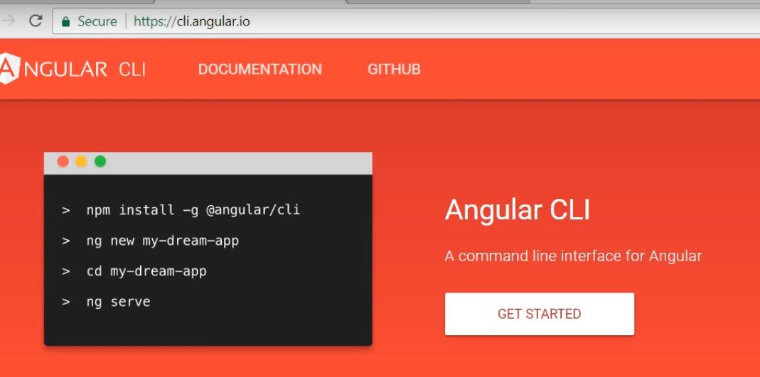

Slide 9
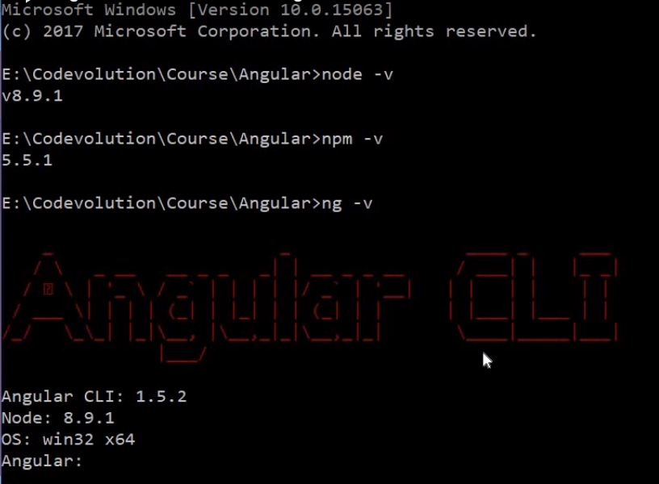

Slide 10
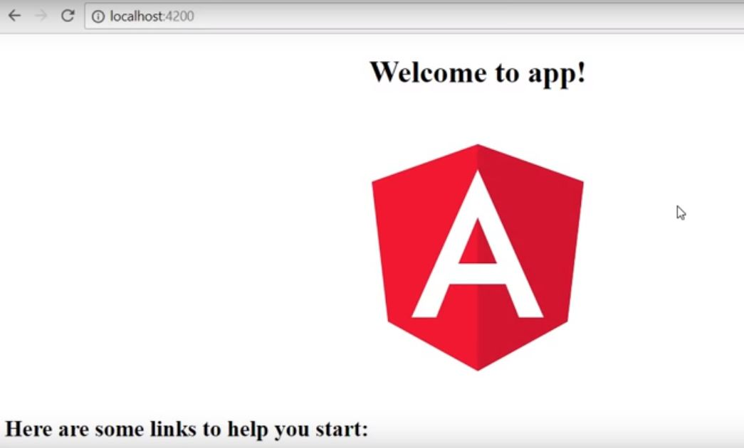

Slide 11
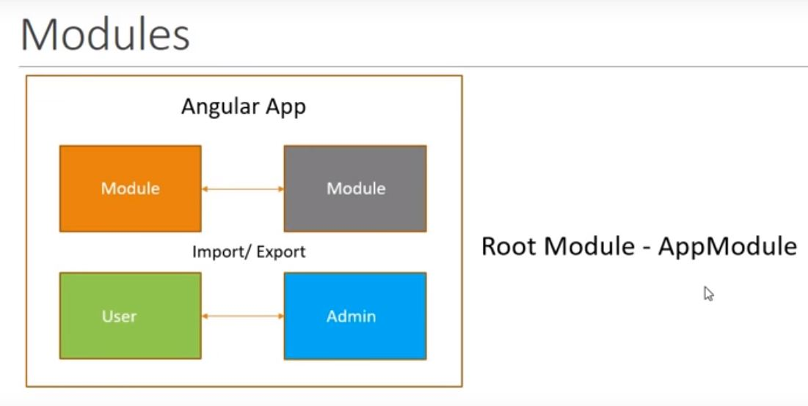

Slide 12
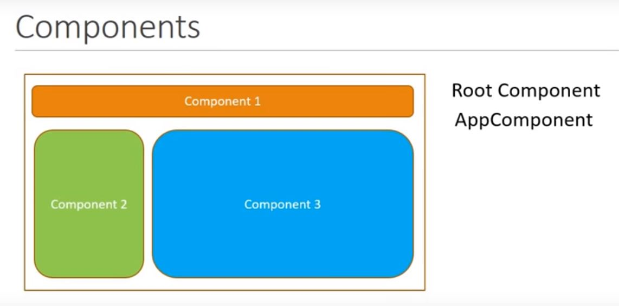

Slide 13
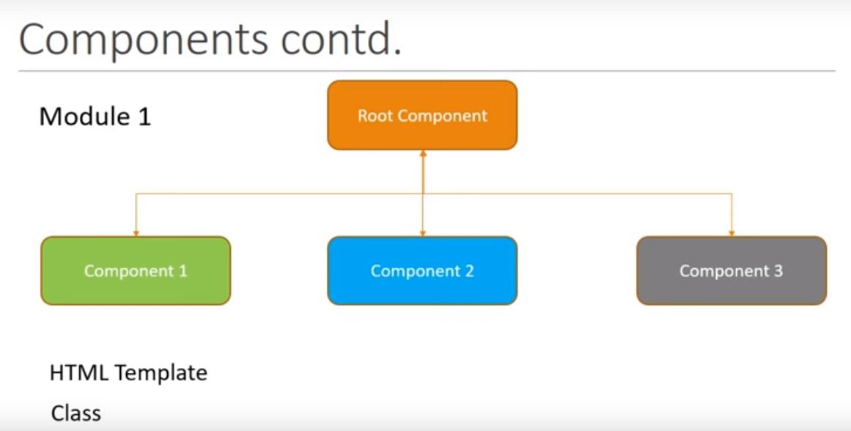

Slide 14
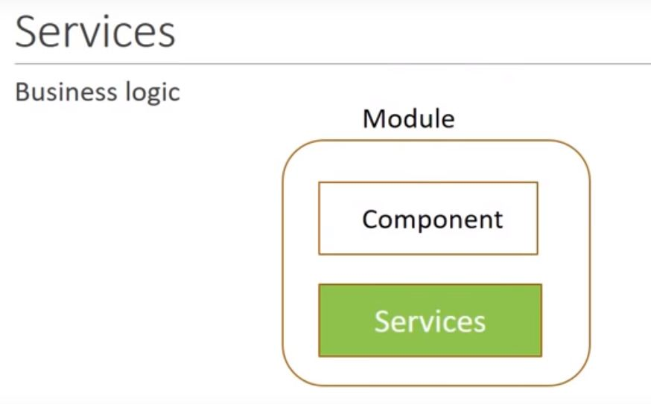

Slide 15
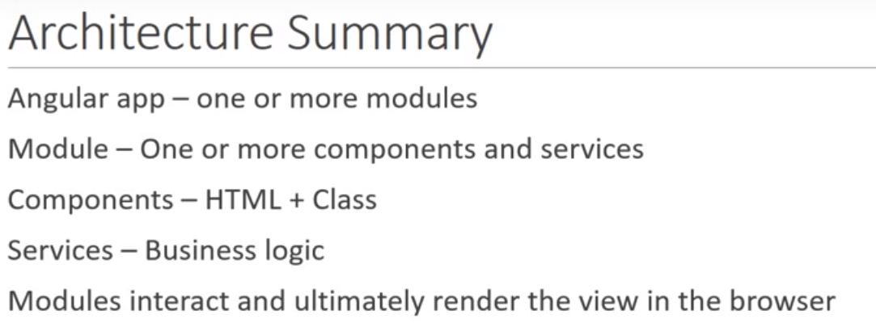

Slide 16
